Slide 1
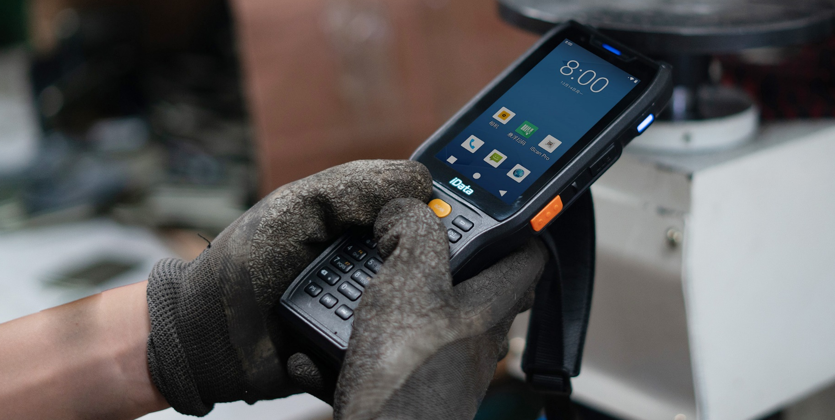
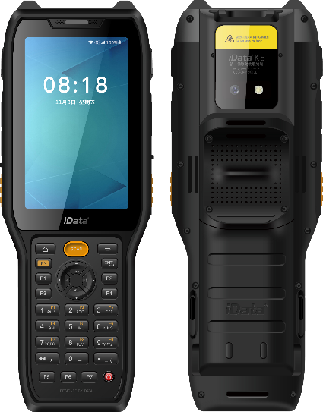
K8
Ultra-rugged Android terminal
Industrial-level durability, long-time reliability
iData K8 is an ultra-rugged Android smart mobile terminal designed for large-scale warehouses, goods transportation centers, and manufacturing factories, etc. K8 features excellent performance and reliability, ultra-long product lifespan. Thus your enterprise can benefit from a single purchase of K8 for a very long time.
Ultra-long product lifespan
K8 has anticipated the future challenges, from the processor, memory to the system and Android subsequent support, the device has taken the future needs into consideration. As a practical hardware, K8 is able to run upgraded system or Apps in the future, which makes it survive longer lifespan and will benefit your enterprise in the long run.
Designed to fit into complex environments
Both the ultra-rugged ingress protection and the ultra-big 6700mAh battery are making the K8 more durable at work. Besides, the device can survive accidental drops from a forklift or long working hours requirement.
Improve operation efficiency for warehouses and factories
Support up to 21.4m furthest scanning, the forklift can quickly scan the barcodes of the shelves and goods in a long distance. With the support of Bluetooth 5.0, K8 can connect to all kinds of earphones, printers and various extensive applications.
Production
Management
Inventory
management
Oil/gas/electricity
management
Construction site
management

Slide 2

K8 Technical Specifications
System Configuration
Scanning Engine
Processor | Octa-core 2.0GHz high-performance processor
Operating System | Android 12.0 (GMS)
Memory (ROM+RAM) | 64GB + 4GB (standard)
SIM | Dual Nano SIM card
Expansion Slot | Micro SD card (up to 256 GB)
Display Screen | 4-inch, resolution: 800*480 pixels IPS HD Retina Screen
Touch Screen | Industrial capacitive screen, support wet-hand operation/glove mode/multi-touch/gesture operation
Camera | 13 megapixels of rear camera, support auto-focus, 5 megapixels of front camera
Flashlight | 800mA flashlight
Keypad | 34 keypads in total: front key*29, side scan key *2, side PTT key *1, side ±volume key *2
Battery | 3.85V lithium battery, with 6700mAh, detachable, backup-battery support
Audio | Built-in dual microphone ( noise-canceling microphone)
Charging Method | Type-C charging and pin port charging, support 9V/2A, 5V/3A fast charging
Reminder | High-power speaker/3 sides scan LED reminder/Vibration reminder/Charging LED reminder
Vibrating Motor | Built-in vibrating motor
Sensors | G-sensor/ Proximity sensor/Light sensor
Intercom Function (Optional) | Support one-button PTT calls
Barcode Type | It can scan one-dimensional / two-dimensional barcodes
Scanning Accuracy | ≧3.33mil
Scanning Angle | Pitch: ±60°； Skew：±45°； Tilt：360°
View Angle | Horizontal：44.3°，Vertical：28.4°，Diagonal：51°
Motion Error Tolerance | 8m/s
Communication Transmission
WWAN (Network Frequency) | China & Eurasian version: 2G：900/1800 3G：WCDMA:B1/B8 4G：FDD-LTE:B1/B3/B7/B8/B20， TDD-LTE:B38/B40 American version: 2G: B2/B3/B5 3G: B1/B2/B4/B5，CDMA&EVDO：BC0/BC1 (U.S.) 4G: B1/B2/B3/B4/B5/B7/B12/B17/B28A/B28B/B41
WWAN (Data Service) | GSM/GPRS/EDGE/CDMA/UMTS/HSPA/HSPA+/EVDO/WCDMA/TD-SCDMA/TDD-LTE/FDD-LTE
WLAN Function | Wi-Fi 802.11a/b/g/n/r/ac (2.4G + 5G dual-band Wi-Fi), support Wi-Fi 5G PA amplifier
Bluetooth | Bluetooth 5.0, support BLE
GPS | GPS
Structure Parameter
NFC (Standard)
Dimension (L*W*D) | 205mm*76mm*31mm
Weight | 440g (including the battery)
Working Frequency | 13.56 MHz
Reading Distance | Within 60 mm
Communication Protocol | ISO14443A/14443B/15693
Environmental Parameter
Working Temperature | -20℃ - 60℃ *Do not charge under low temperature conditions for the safety Concerns
Storage Temperature | -40℃ - 70℃
Humidity | 0 - 95% (no moisture condensation)
Drop Specification | Multiple drops to concrete floor from the height of 1.5m (without protective case) Multiple drops to concrete floor from the height of 1.8m (with protective case)
Roller Drop Specification | 1000 times of roller drops from a height of 0.5 meter
Ingress Protection | IP68
ESD Protection | ±15KV (air discharge), ±8KV (contact discharge)
Development Support
Programming Language | Java
Development API | iScan API (Scanning Development Kits), Device API (Device Management/Configuration Development Kits), Android Standard Interface
Development Tool | Eclipse/Android Studio
Accessories (More details in accessories guide)
Communication Interface
Standard Accessories | USB cable*1, hand strap *1, power adapter*1,device-back strap*1, battery*1
Optional Accessories | Single charging cradle, bottom charger, 4-slot charging cradle, 4-slot battery charging cradle, pistol grip, protective case
USB Interface | Type-C (with headset function) *1
OTG Interface | Support
The information of iData products and software service may be subject to change without notice. Please contact your iData sales representative for the latest details.
WUXI IDATA TECHNOLOGY COMPANY LTD.
Address: Floor 11, Building B1, Wuxi (Binhu) National Sensing Information Center,
No.999 Gaolang East Road, Wuxi City,Jiangsu Province ,P.R.C.
E-mail: sales@idataglobal.com
Website: www.idataglobal.com
Official Website

Slide 3
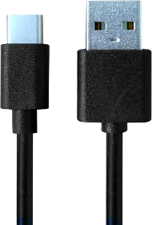
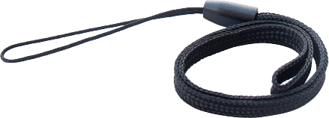
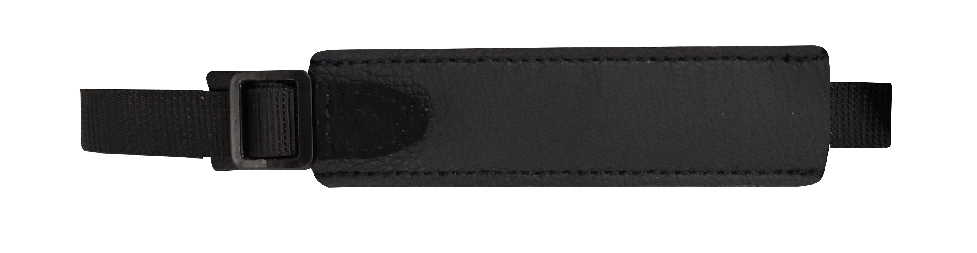
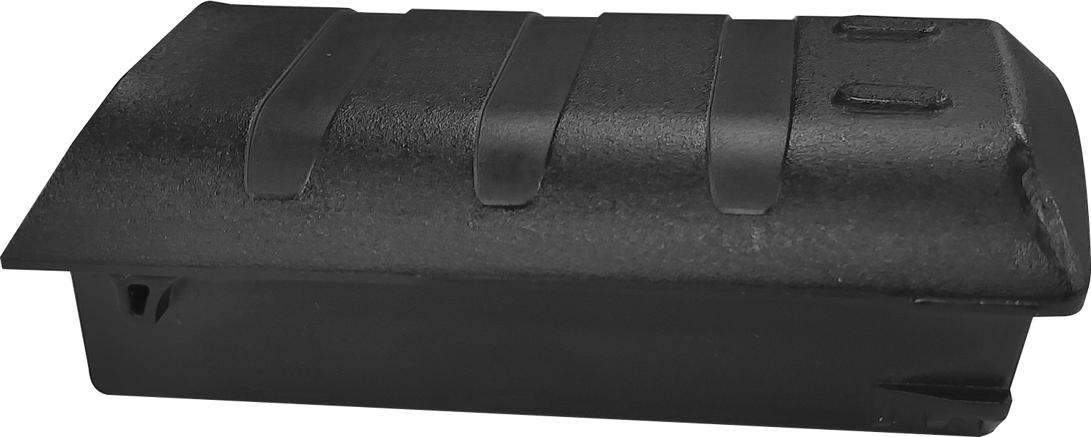
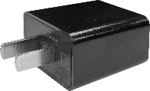
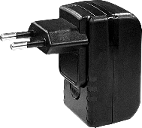
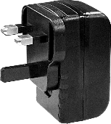
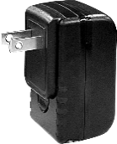
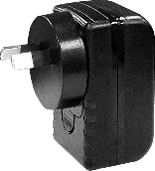
K8 Standard Accessories
Accessories Guide
Each product comes with a pack of practical and cost-effective accessories
USB Cable
Hand Strap
Type-C to USB cable, 1m in length, support charging and data transmission
Wear on your wrist to carry the device, avoid accidental drops, and assure the safety of equipment
CHA-USBC-GNR
MNT-HS-GNR
Device-back Strap
Battery
Attach on the device back to help you hold the device easily and firmly, avoid accidental drops
6700mAh, detachable design.
ps: every product comes with 1 unit, you can purchase extra unit
MNT-BS-K8
CHA-BTRY-K8-6700MA
Power Adapter
Input voltage 100-240V, output 5V2A. Support plug types of China/Europe/UK/US/Australia, match with CHA-USBC-GNR
ps: you may have one of the power adapters
CHA-PWAD-
GNR-5V2A-CN
CHA-PWAD-
GNR-5V2A-EU
CHA-PWAD-
GNR-5V2A-UK
CHA-PWAD-
GNR-5V2A-US
CHA-PWAD-
GNR-5V2A-AU

Slide 4
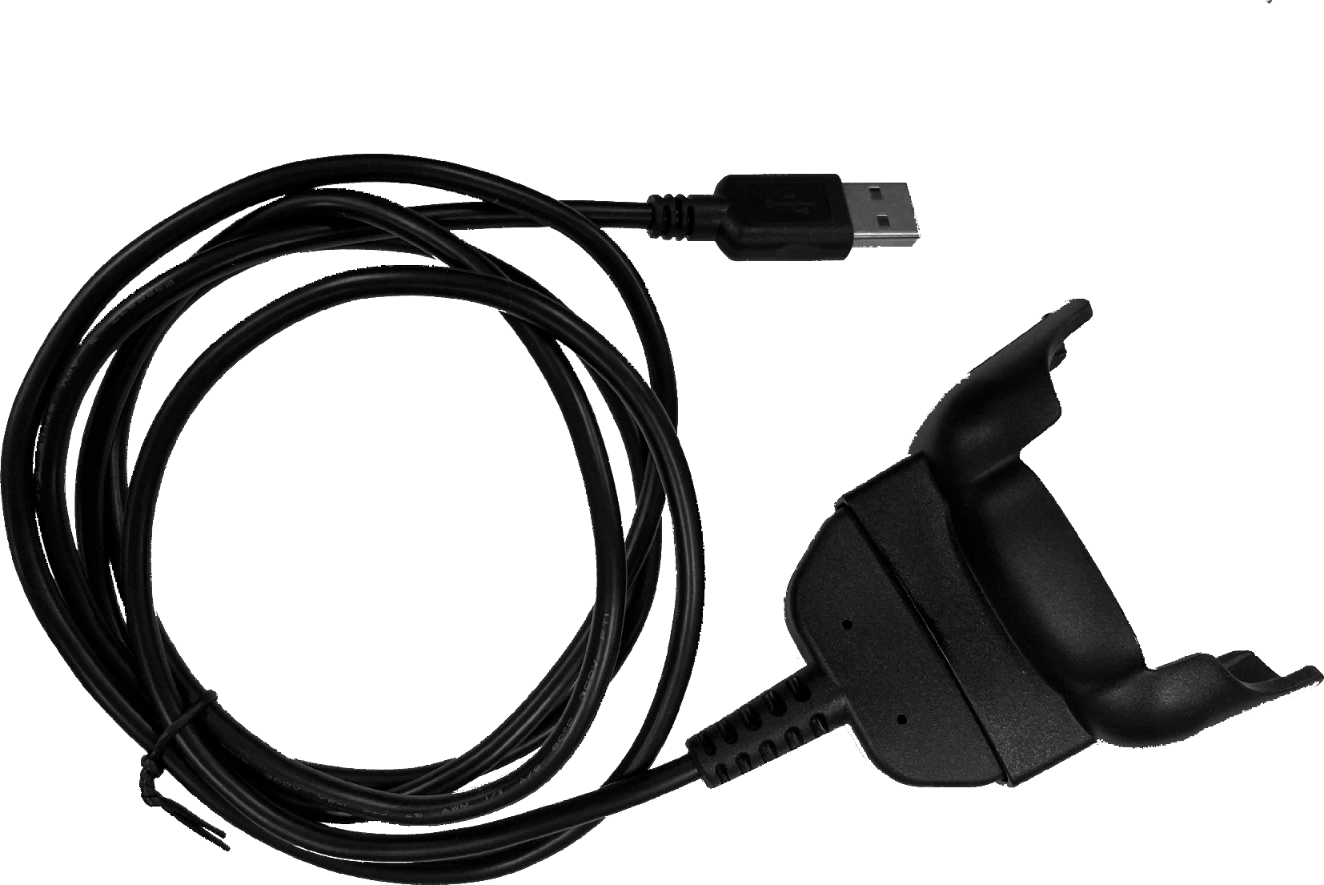
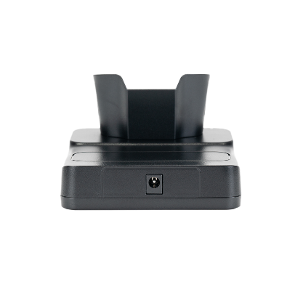
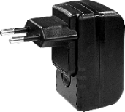
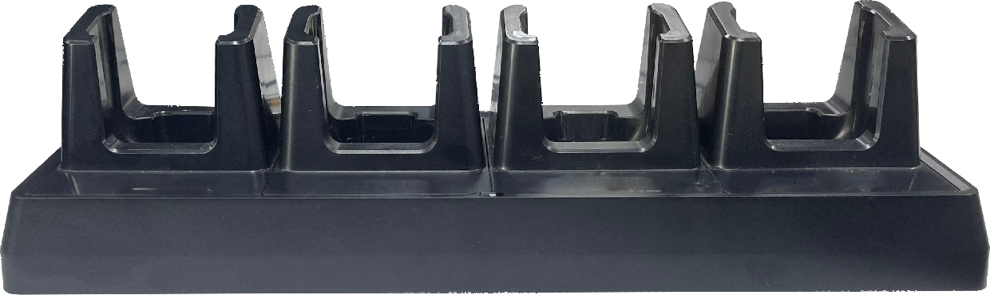
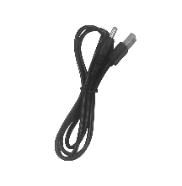
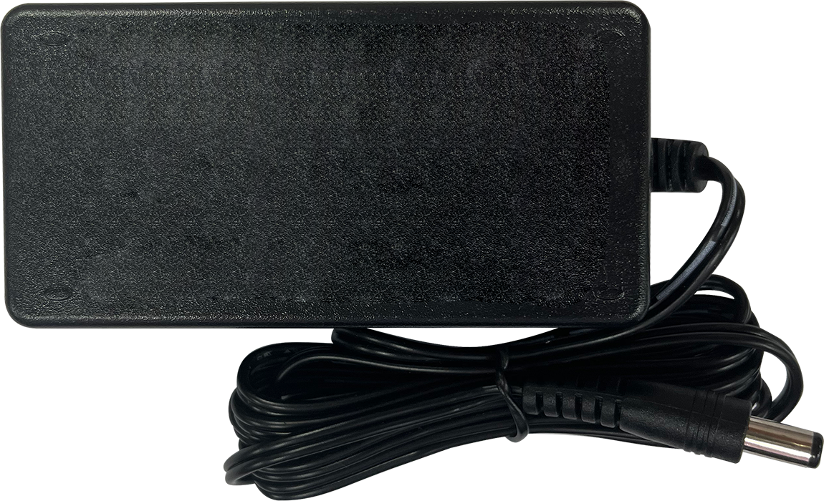
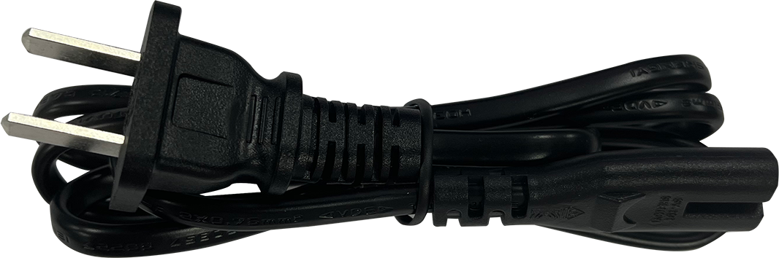
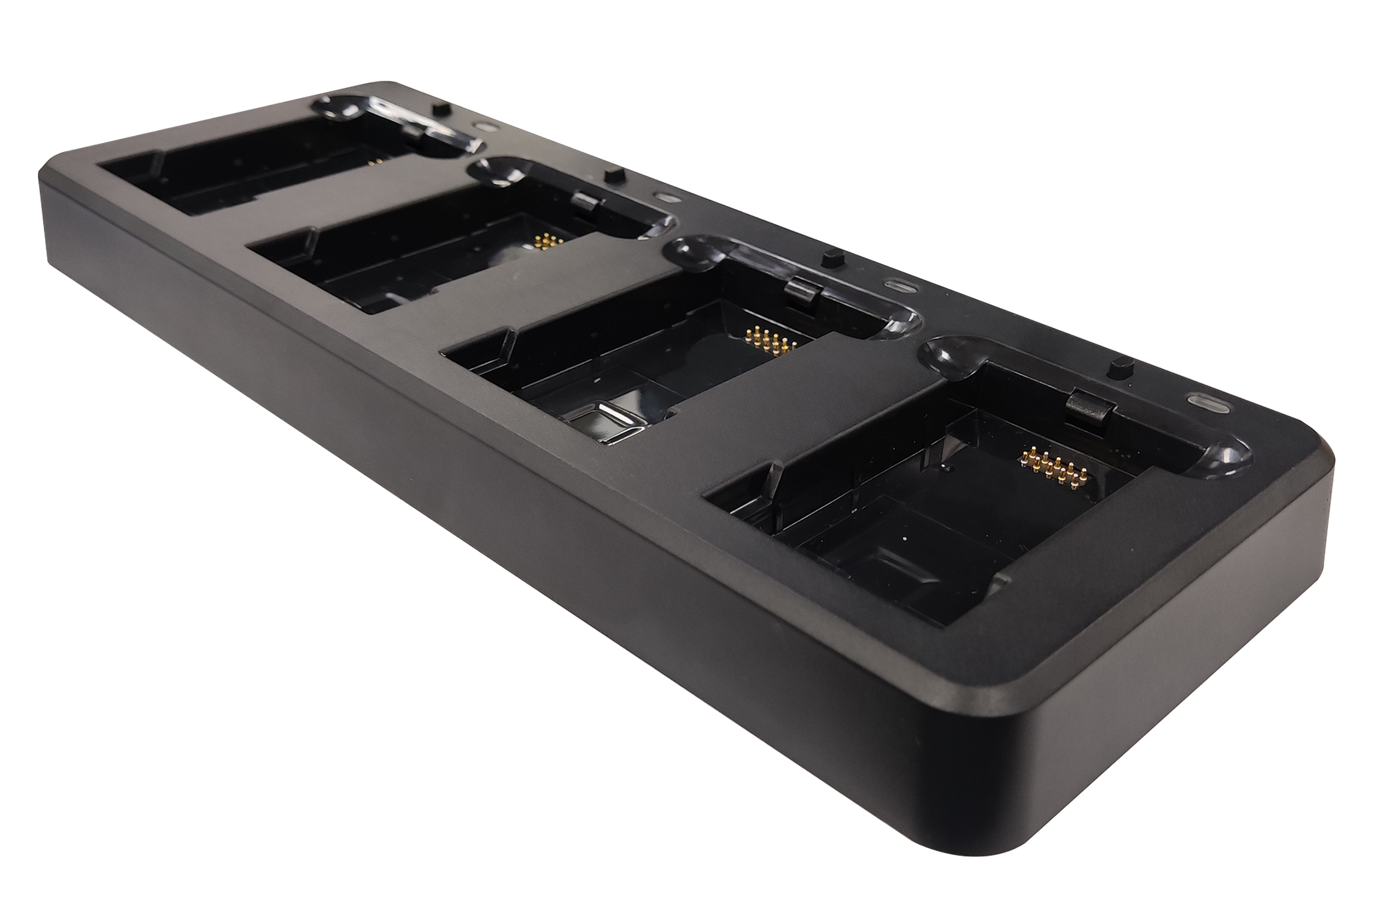
K8 Optional Accessories for Charging
Accessories Guide
Improve management efficiency of devices and operational level of enterprises
Bottom Charger
Battery
Bottom charger for the main unit, support charging for 1 device. USB-A port, can connect with CHA-PWAD-GNR-5V2A-XX accessory
6700mAh, detachable design.
ps: every product comes with 1 unit, you can purchase extra unit
CHA-BTC-K8
CHA-BTRY-K8-6700MA
Single Charging Cradle
4-slot Charging Cradle
Support charging for 1 main unit. Support plug types of China/Europe/UK/US/Australia
Support maximum charging of 4 main units at the same time. Support plug types of China/Europe/UK/US/Australia
ps: you may have one of the power adapters
ps: you may have one of the power adapters
CHA-CRD1S-K8
CHA-CRD4S-K8
4-slot Battery Charging Cradle
Support maximum charging of 4 batteries at the same time. Support plug types of China/Europe/UK/US/Australia
ps: you may have one of the power adapters
CHA-CRD4B-K8

Slide 5
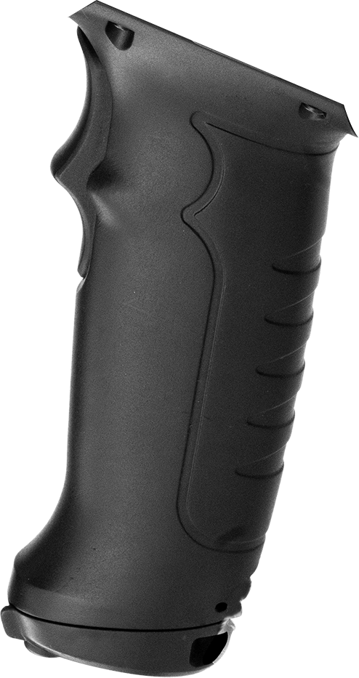
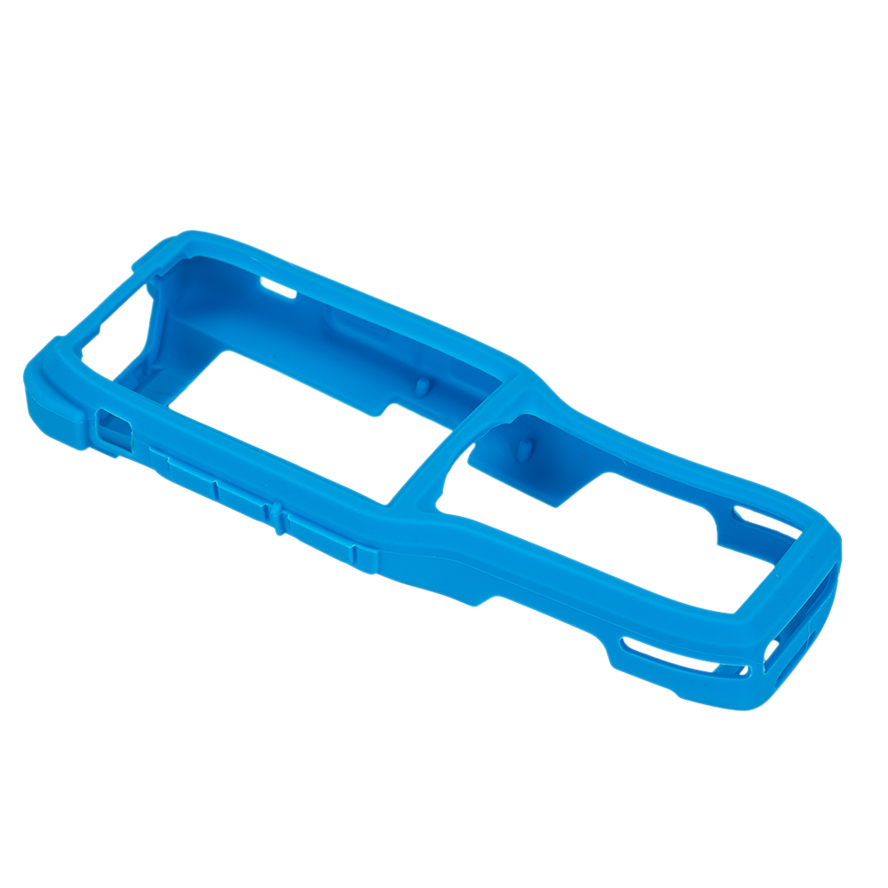
K8 Optional Accessories for Portability
Accessories Guide
Improve device portability and comfort for users, boost working efficiency
Pistol Grip
Pistol grip for main unit. Execute barcode scanning by pressing the grip trigger. Only those main units with pin port on the back are compatible
MNT-PG-K8
K8 Optional Accessories for Protection
Accessories Guide
Lower risks of malfunction during usage, extend lifespan of devices
Protective Case
Protective case for the main unit. It can prevent the malfunction of main unit in case there’s any accidental drops or impact during usage
PRT-PTC-K8
The information of iData products and software service may be subject to change without notice. Please contact your iData sales representative for the latest details.
.
WUXI IDATA TECHNOLOGY COMPANY LTD.
Address: Floor 11, Building B1, Wuxi (Binhu) National Sensing Information Center,
No.999 Gaolang East Road, Wuxi City,Jiangsu Province ,P.R.C.
E-mail: sales@idataglobal.com
Website: www.idataglobal.com
Official Website

